Slide 1

Methods in Information Systems Design

Slide 2
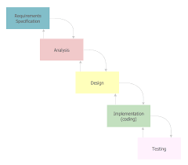
SSADM
1. Structured Systems Analysis and Design Methodology (SSADM): A waterfall method for the analysis and design of information systems, consisting of stages such as feasibility study, requirements analysis, system design, and implementation.

Slide 3
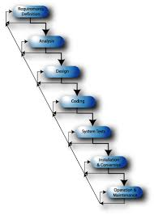
OOAD
2-Object-Oriented Analysis and Design (OOAD): A methodology that models a system as a collection of interacting objects, focusing on encapsulation, inheritance, and polymorphism.

Slide 4
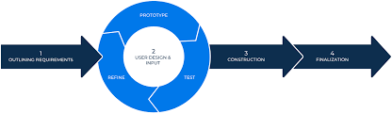
RAD
3-Rapid Application Development (RAD): An iterative approach to software development that emphasizes rapid prototyping and quick feedback from users.

Slide 5

UML
4-Unified Modeling Language (UML): A standardized modeling language used for visualizing, specifying, constructing, and documenting the artifacts of software systems, including class diagrams, sequence diagrams, and use case diagrams.

Slide 6

Levels of Creation of Functional Methodology
1. IDEF0 (Integration Definition for Function Modeling): - IDEF0 is a modeling language used to produce a "function model" of a system, often represented as a hierarchical diagram of functions, inputs, outputs, and controls. - It helps in understanding the functions of a system and how they relate to each other. - IDEF0 diagrams are typically created during the early stages of system analysis and design to capture high-level functional requirements.

Slide 7
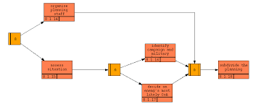
IDEF3
. IDEF3 (IDEF Process Description Capture Method): - IDEF3 is used to describe the detailed dynamics of processes within a system. - It captures the flow of activities, decisions, and events that occur during the execution of processes. - IDEF3 diagrams are often used in conjunction with other modeling techniques such as IDEF0 and DFDs to provide a comprehensive view of system processes.

Slide 8
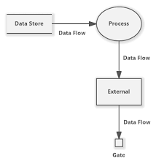
DFDs
3. Data Flow Diagrams (DFDs): - DFDs depict the flow of data within a system, showing how data moves from input sources to processing functions and output destinations. - They consist of processes, data stores, data flows, and external entities. - DFDs are widely used during system analysis and design to model the data flow and transformation within a system.

Slide 9
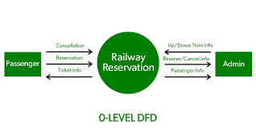
summary
In summary, Information Systems Design involves adhering to principles such as modularity, abstraction, and scalability, and utilizing methodologies such as SSADM, OOAD, and RAD. Additionally, functional methodologies like IDEF0, IDEF3, and DFDs help in creating visual representations of system functions, processes, and data flows at different levels of detail. These principles, methods, and standards play a crucial role in designing effective and efficient information systems.

